Slide 1

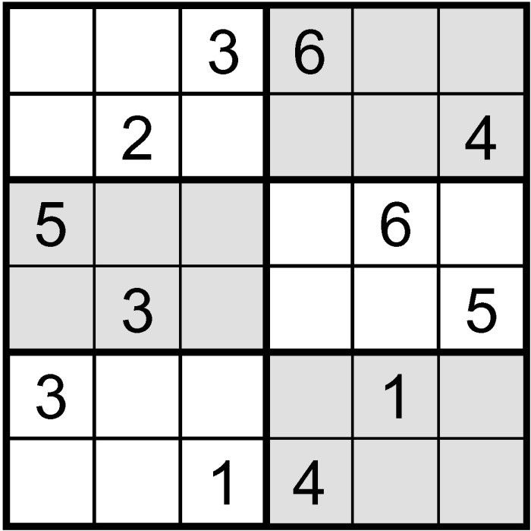
Sudoku Solver Using CSP
(Arc Consistency)
Introduction To Artificial Intelligence
Presented By:
Karri Venkata Masthan Sai Nishant (00749323)
Prajwal Reddy Nallamaddi (00749350)

Slide 2
OBJECTIVES
Design Constraint Satisfaction Problem agents to solve the Sudoku.
Play the Sudoku with the designed model.
Sudoku game logic depends on
1. When a digit is placed in a box, same digit cannot be placed in same row or column.
2. When every row and column is filled by satisfying the constraints , the resultant Sudoku is returned.

Slide 3
What is Sudoku?
A basic Sudoku is…
A game of logic where the player must assign the numbers
1..6 to cells on a 6x6 grid. The placement of the numbers must be such that every number must appear exactly once in every row, column, and 3x3 block, where the board is split into six 3x3 blocks.

Slide 4

Our Approach
Define Variables, Domains
Define
Constraints
01
04
02
Filtering search using Arc Consistency to solve CSP
03
Using Backtracking search
Notes:
Notes to presenter:
What did you think at first?
What obstacles did you encounter along the way?
How did you overcome those obstacles?
What images can you add to support your process?
This SmartArt allows you add images and text to help outline your process. If a picture is worth a thousand words, then pictures and words should help you communicate this reflection on learning perfectly! You can always click on Insert>SmartArt to change this graphic or select the graphic and click on the Design contextual menu to change the colors.
Feel free to use more than one slide to reflect upon your process. It also helps to add some video of your process.

Slide 5
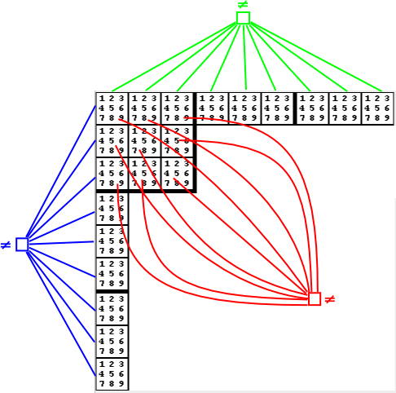
Our Approach
We model Sudoku as a CSP as follows.
Each cell is a variable whose domain is made of the numbers 1…6.
The constraints correspond to all-diff constraints on each row, column, and block.
Arc Consistency (AC) is even stronger, considering every non-binary all-diff constraint and removing inconsistent values.
Notes:
Notes to presenter:
What did you think at first?
What obstacles did you encounter along the way?
How did you overcome those obstacles?
What images can you add to support your process?
This SmartArt allows you add images and text to help outline your process. If a picture is worth a thousand words, then pictures and words should help you communicate this reflection on learning perfectly! You can always click on Insert>SmartArt to change this graphic or select the graphic and click on the Design contextual menu to change the colors.
Feel free to use more than one slide to reflect upon your process. It also helps to add some video of your process.

Slide 6
Deliverables
User documentation manual which gives details about the sudoku game implementation using CSP.
Algorithms developed for Learning agent using python programming language(.py files)
GitHub repository link for project code and related files.
YouTube video demonstrating project implementation and slides.
Notes:
Notes to presenter:
What is your purpose for sharing this reflection?
Is it at the end of a unit or project?
Are you sharing this reflection, at the attainment of a learning goal you set for yourself?
Is it at the end of a course?
State your purpose for the reflection or even the purpose of the learning experience or learning goal. Be clear and be specific in stating your purpose.

Slide 7
Game Layout
The designed Sudoku game is a 6 * 6 grid.
The blank space is filled with 0 or (.) while entering the input.
The 6 * 6 grid with the filled Sudoku is returned as output.

Slide 8
Results
(base) nishantsai@Nishants-MacBook-Pro Sudoku-Solver-master % python ArcConsistency.py
Enter the Sudoku grid you want to solve (indicate blank spaces with 0 or .): 003010560320054203206450012045040100
4 2 3 |5 1 6
5 6 1 |3 2 4
------+------
1 5 4 |2 6 3
2 3 6 |4 5 1
------+------
3 1 2 |6 4 5
6 4 5 |1 3 2

Slide 9
Results
(base) nishantsai@Nishants-MacBook-Pro Sudoku-Solver-master % python ArcConsistency.py
Enter the Sudoku grid you want to solve (indicate blank spaces with 0 or .): 260501001002400060030004100400304026
2 6 3 |5 4 1
5 4 1 |6 3 2
------+------
4 1 2 |3 6 5
6 3 5 |2 1 4
------+------
1 2 6 |4 5 3
3 5 4 |1 2 6

Slide 10
Results
(base) nishantsai@Nishants-MacBook-Pro Sudoku-Solver-master % python ArcConsistency.py
Enter the Sudoku grid you want to solve (indicate blank spaces with 0 or .): 5….1.1..5...43....25...6..4.2....5
5 2 3 |4 6 1
4 1 6 |2 5 3
------+------
1 5 4 |3 2 6
6 3 2 |5 1 4
------+------
3 6 5 |1 4 2
2 4 1 |6 3 5

Slide 11
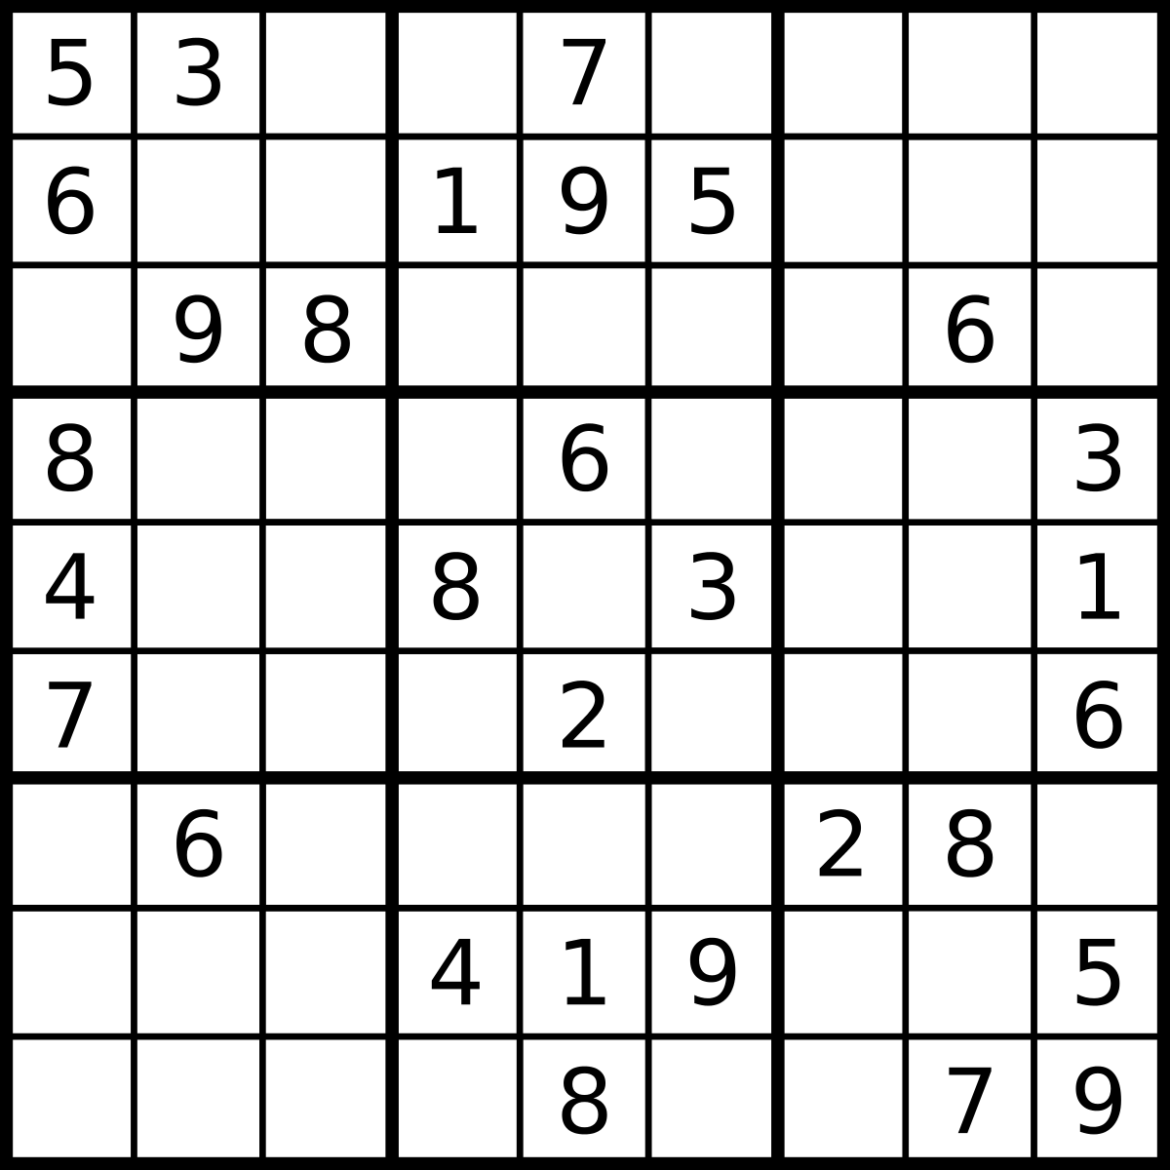
Metrics
Correctness
Time Complexity:Optimal time for all the Learning agents implemented.
Space Complexity :space complexity for all the Learning agents implemented.
Accuracy
As it’s a team project, the contribution of the teammates and their communication should also be considered
Notes:
Notes to presenter:
What is your purpose for sharing this reflection?
Is it at the end of a unit or project?
Are you sharing this reflection, at the attainment of a learning goal you set for yourself?
Is it at the end of a course?
State your purpose for the reflection or even the purpose of the learning experience or learning goal. Be clear and be specific in stating your purpose.

Slide 12
Analysis
Correctness: Every time we run sudoku on different inputs each time we get the correct output satisfying all constraints.
Time Complexity: Ω(n)
Space Complexity : O(1)
Accuracy: Every time we are getting correct sudoku formation for each different types of inputs, hence the constraints are satisfied accurately.
Notes:
Notes to presenter:
What is your purpose for sharing this reflection?
Is it at the end of a unit or project?
Are you sharing this reflection, at the attainment of a learning goal you set for yourself?
Is it at the end of a course?
State your purpose for the reflection or even the purpose of the learning experience or learning goal. Be clear and be specific in stating your purpose.

Slide 13
THANK YOU

